Slide 1
Welcome to
Step by step
3 days
Web Design Training

Slide 2
Training Topics
What is Website
Types of Website
Types of Web Development
What is Web Design
Web Designer Market Demand
HTML and CSS Concept
Code Editor
Build Projects Using HTML & CSS

Slide 3
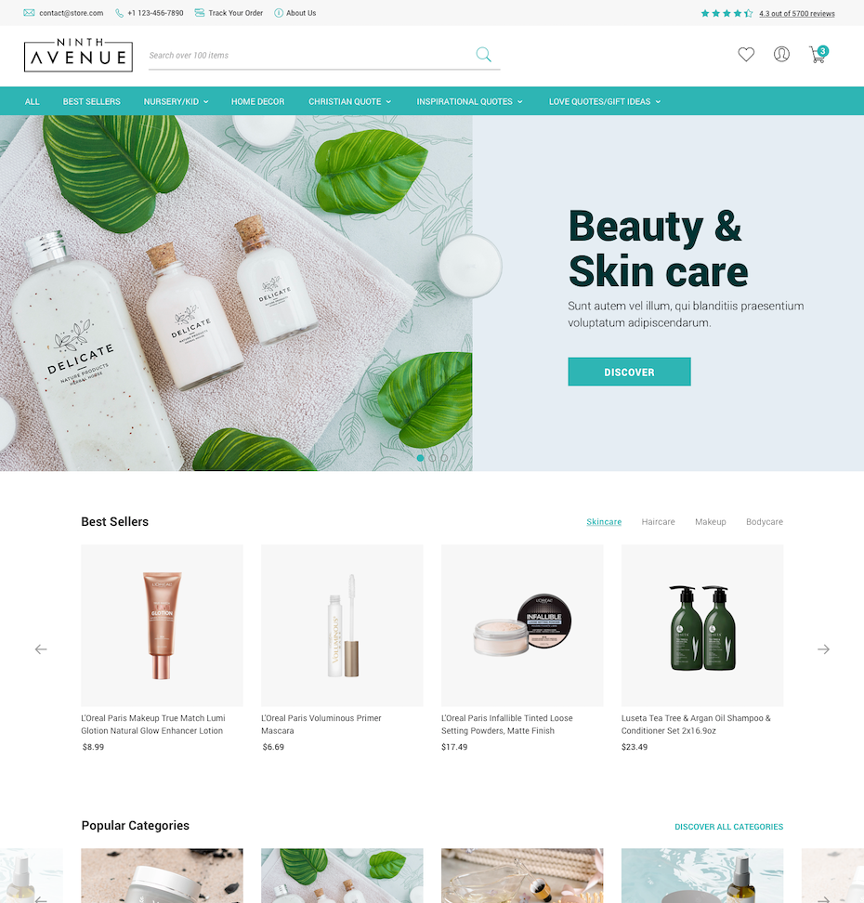
What is
Website?
# Information, images, videos and other multimedia content.
# Written using HTML, CSS.
# Displayed in a web browser

Slide 4




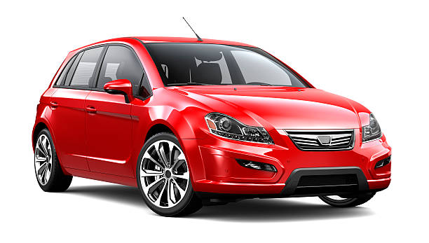

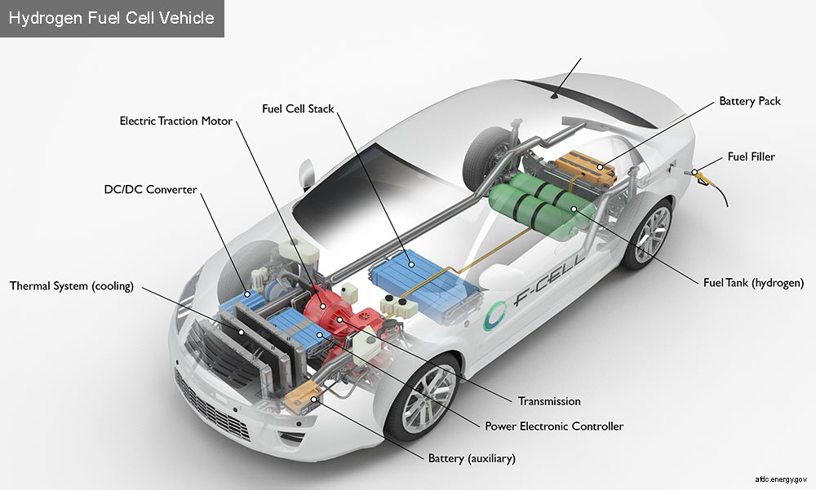





Popular Front-end Technologies
Web Development Types
Front-end
Back-end

Slide 5
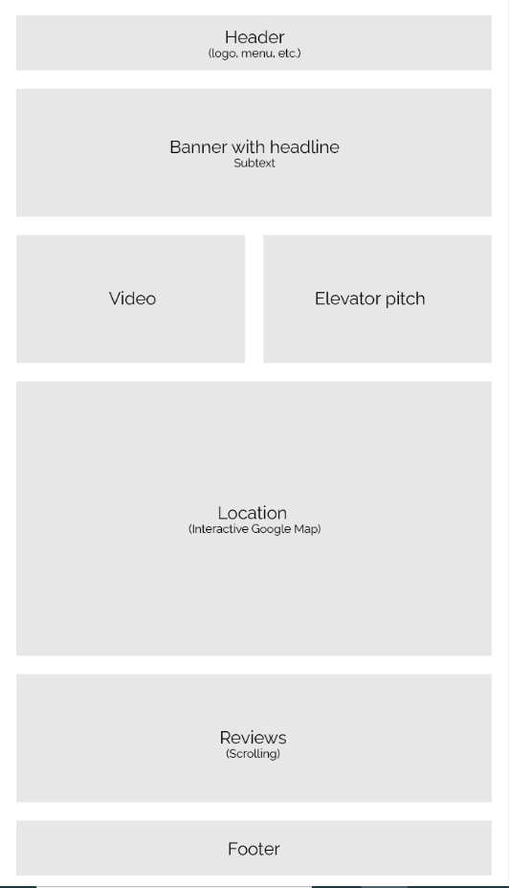
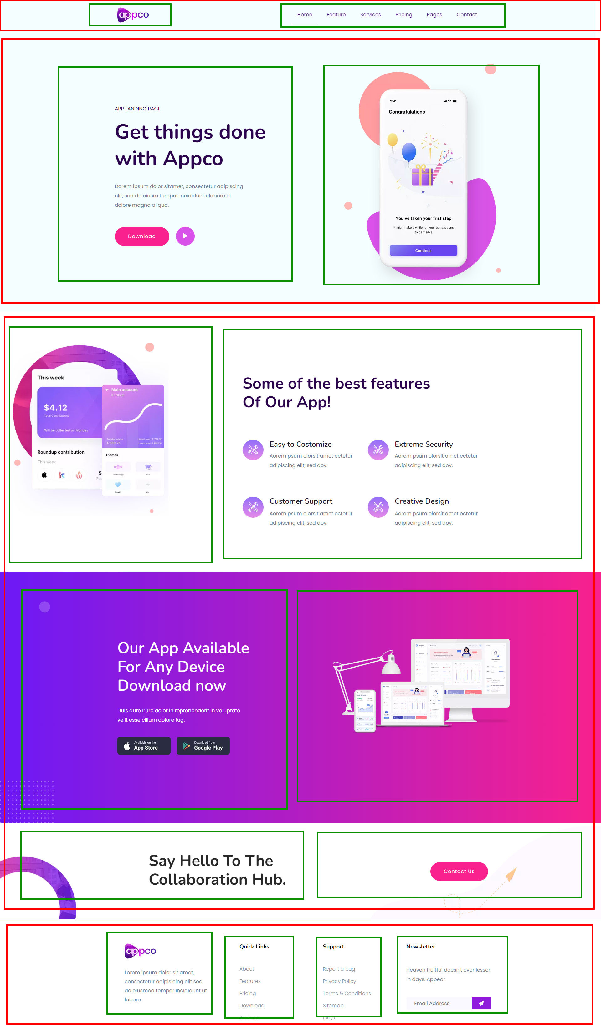


Website Layout

Slide 6
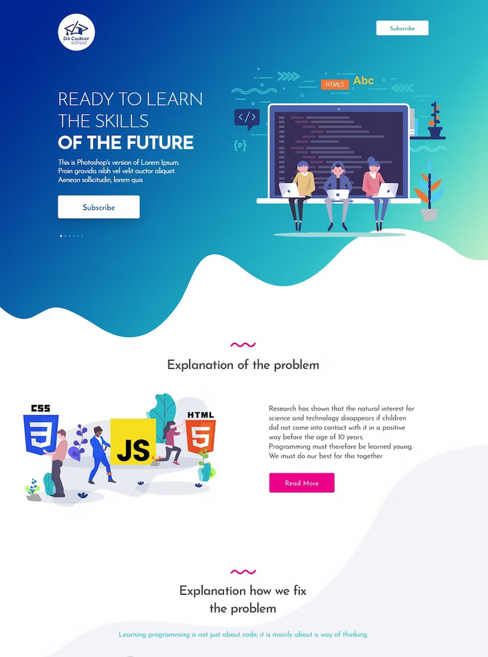
What is
Web Designing?
Creating LAYOUT of website
Designing VISUAL appearance

Slide 7






Opportunities?
Local Jobs
Remote Jobs
Freelancing

Slide 8
HTML Topics
Let’s do some Live Practice

